Slide 1
Module 2
Process Management
-Manya Gidwani

Slide 2
What is an Operating System?
A program that acts as an intermediary between a user of a computer and the computer hardware
Operating system goals:
Execute user programs and make solving user problems easier
Make the computer system convenient to use
Use the computer hardware in an efficient manner

Slide 3
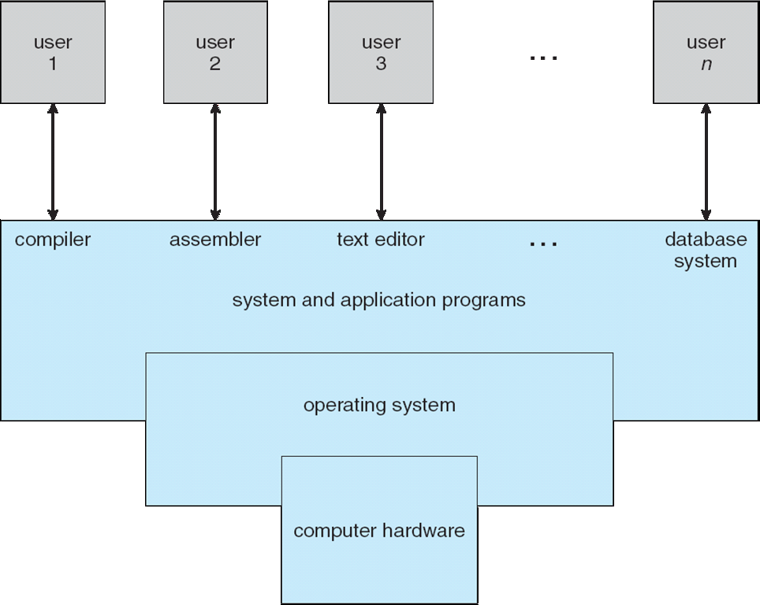
Four Components of a Computer System

Slide 4
Process Management
A process is a program in execution. It is a unit of work within the system. Program is a passive entity, process is an active entity.
Process needs resources to accomplish its task
CPU, memory, I/O, files
Initialization data
Process termination requires reclaim of any reusable resources
Single-threaded process has one program counter specifying location of next instruction to execute
Process executes instructions sequentially, one at a time, until completion
Multi-threaded process has one program counter per thread
Typically system has many processes, some user, some operating system running concurrently on one or more CPUs
Concurrency by multiplexing the CPUs among the processes / threads

Slide 5
Process Management Activities
The operating system is responsible for the following activities in connection with process management:
Creating and deleting both user and system processes
Suspending and resuming processes
Providing mechanisms for process synchronization
Providing mechanisms for process communication
Providing mechanisms for deadlock handling

Slide 6
Process Concept
An operating system executes a variety of programs:
Batch system – jobs
Time-shared systems – user programs or tasks
Textbook uses the terms job and process almost interchangeably
Process – a program in execution; process execution must progress in sequential fashion
A process includes:
program counter
stack
data section

Slide 7
The Process
Multiple parts
The program code, also called text section
Current activity including program counter, processor registers
Stack containing temporary data
Function parameters, return addresses, local variables
Data section containing global variables
Heap containing memory dynamically allocated during run time
Program is passive entity, process is active
Program becomes process when executable file loaded into memory
Execution of program started via GUI mouse clicks, command line entry of its name, etc
One program can be several processes
Consider multiple users executing the same program

Slide 8
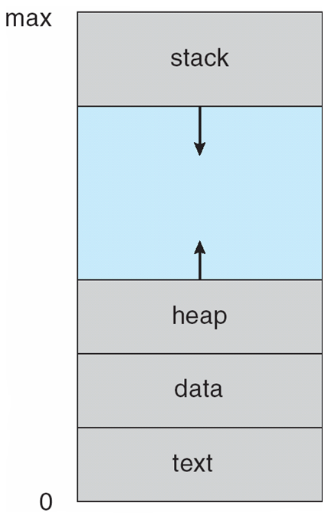
Process in Memory

Slide 9
Process State
As a process executes, it changes state
new: The process is being created
running: Instructions are being executed
waiting: The process is waiting for some event to occur
ready: The process is waiting to be assigned to a processor
terminated: The process has finished execution

Slide 10
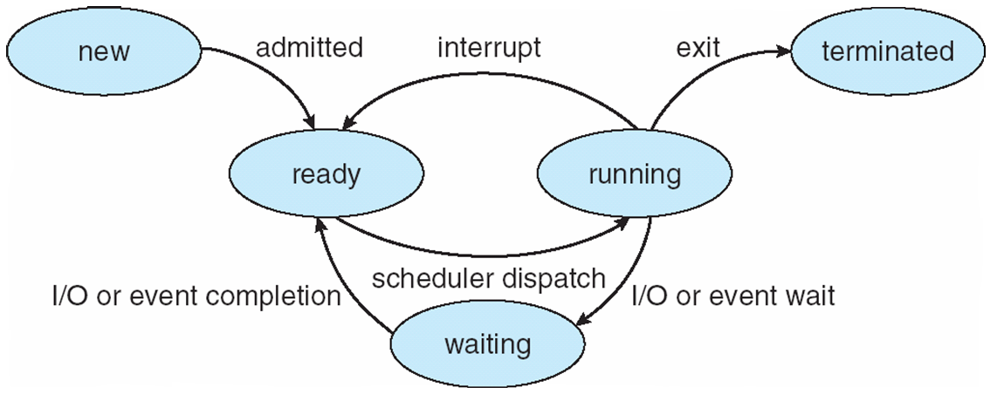
Diagram of Process State

Slide 11
Process Control Block (PCB)
Each Process is represented in the OS BY PCB also known as task control block ,Information associated with each process
Process state
Program counter
CPU registers
CPU scheduling information
Memory-management information
Accounting information
I/O status information

Slide 12
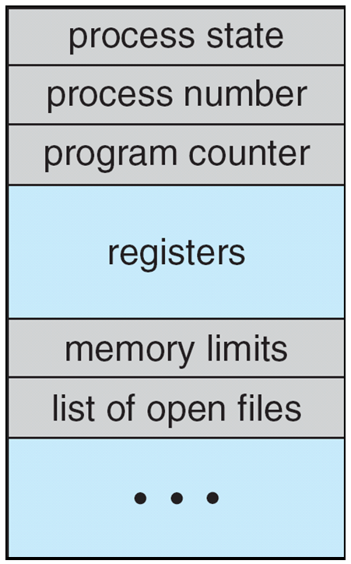
Process Control Block (PCB)

Slide 13
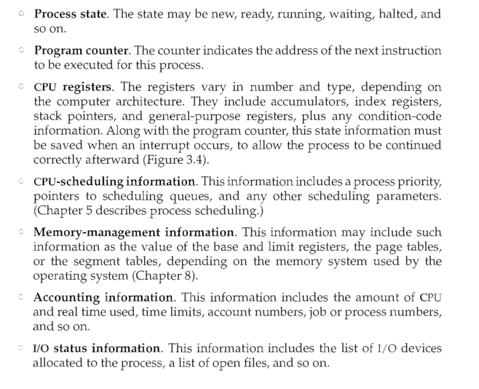

Slide 14
Threads (context switching )
The process model discussed so far has implied that a process is a program that performs a single thread of execution.
For example, when a process is running a word-processor program, a single thread of instructions is being executed. This single thread of control allows the process to perform only one task at one time
The user cannot simultaneously type in characters and run the spell checker within the same process, for example. Many modern operating systems have extended the process concept to allow a process to have multiple threads of execution and thus to perform more than one task at a time. On a system that supports threads, the PCB is expanded to include information for each thread.

Slide 15
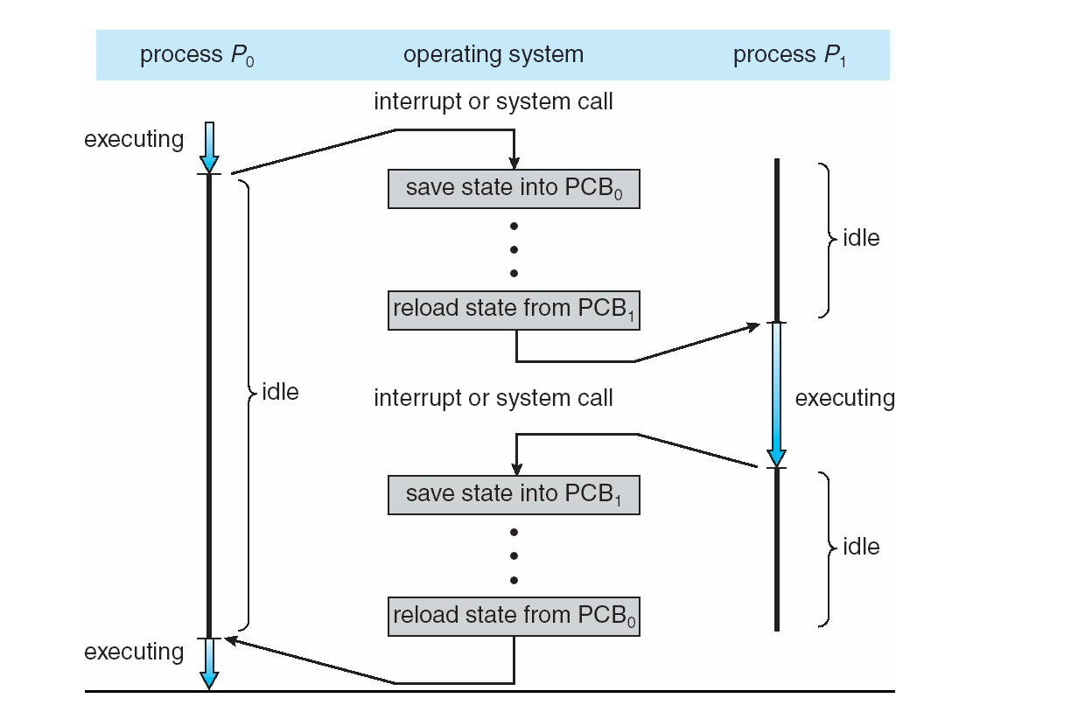
CPU Switch From Process to Process

Slide 16
Process Scheduling
Maximize CPU use, quickly switch processes onto CPU for time sharing
Process scheduler selects among available processes for next execution on CPU
Maintains scheduling queues of processes
Job queue – set of all processes in the system
Ready queue – set of all processes residing in main memory, ready and waiting to execute
Device queues – set of processes waiting for an I/O device
Processes migrate among the various queues

Slide 17
process scheduler
The objective of multiprogramming is to have some process running at all times, to maximize CPU utilization.
The objective of time sharing is to switch the CPU among processes so frequently that users can interact with each program while it is running.
To meet these objectives, the process scheduler selects an available process (possibly from a set of several available processes) for program execution on the CPU.
For a single-processor system, there will never be more than one running process. If there are more processes, the rest will have to wait until the CPU is free and can be rescheduled.

Slide 18
Procedure
As processes enter the system, they are put into a job queue, which consists of all processes in the system.
The processes that are residing in main memory. And are ready and waiting to execute are kept on a list called the ready queue.
Refer: queing diagram

Slide 19
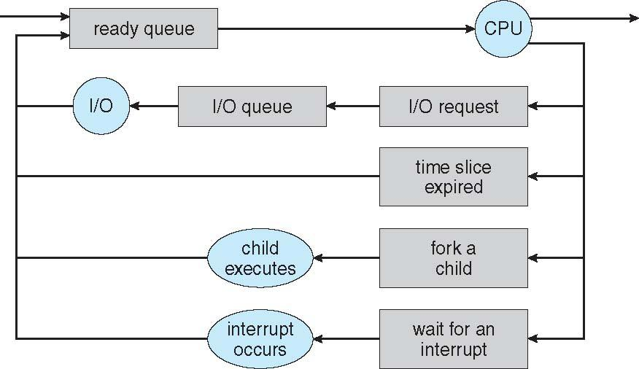
Representation of Process Scheduling

Slide 20
A common representation of process scheduling is a queueing diagram,
Each rectangular box represents a queue. Two types of queues are present: the ready queue and a set of device queues. The circles represent the resources that serve the queues, and the arrows indicate the flow of processes in the system. A new process is initially put in the ready queue. It waits there until it is selected for execution, or is dispatched. Once the process is allocated the CPU and is executing, one of several events could occur:
The process could issue an I/0 request and then be placed in an I/0 queue.
The process could create a new subprocess and wait for the subprocess's termination.
The process could be removed forcibly from the CPU, as a result of an
interrupt, and be put back in the ready queue.

